Slide 1
Microprocessor System Design
DRAM Interfacing
Omid Fatemi
(omid@fatemi.net)

Slide 2
Outline
A Dynamic cell
Reading / Writing DRAM
RAS / CAS signals
DRAM in PC
  RAS, CAS and address select generation
  Address multiplexing
Wait state generation for IO access

Slide 3
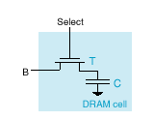
Dynamic RAM
Capacitor can hold charge
Transistor acts as gate
No charge is a 0
Can close switch & add charge to store a 1
Then open switch (disconnect)
Can read by closing switch
  Sense amps

Slide 4



Hydraulic Analogy
Storage
Full (1)
Empty (0)
Pump fills tank to 1 value
Pump drains tank to 0 value

Slide 5


Reading
Outside water begins at intermediate level (black wavy line)
Tank had a 1 value – raises water level
Tank had a 0 value – lowers water level

Slide 6
DRAM Refreshing
Refresh
  Destructive read
  Also, there’s steady leakage
  Charge must be restored periodically

Slide 7
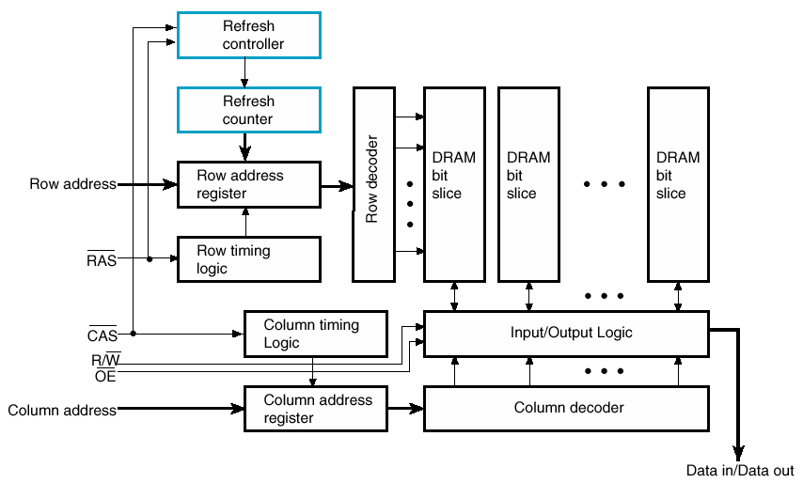
DRAM Logical Diagram

Slide 8
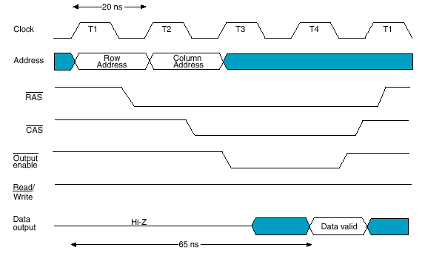
DRAM Read Signaling
Lower pin count by using same pins for row and column addresses
Delay until data available

Slide 9
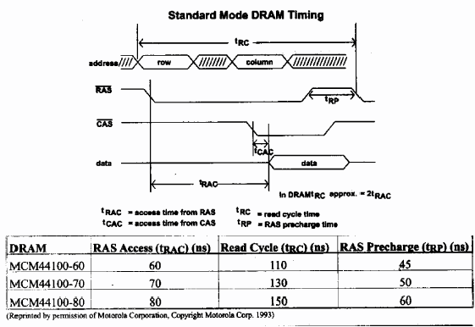
Standard DRAM Timing

Slide 10
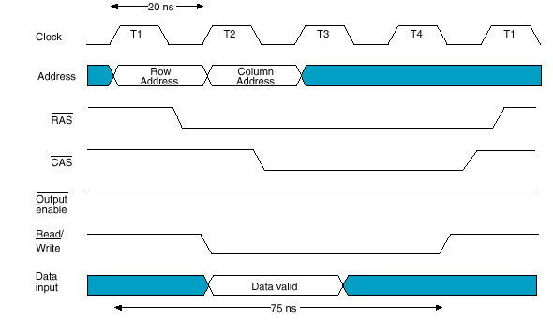
DRAM Write Timing

Slide 11
DRAM Address Select

Slide 12
DRAM Timing (signal generation)

Slide 13
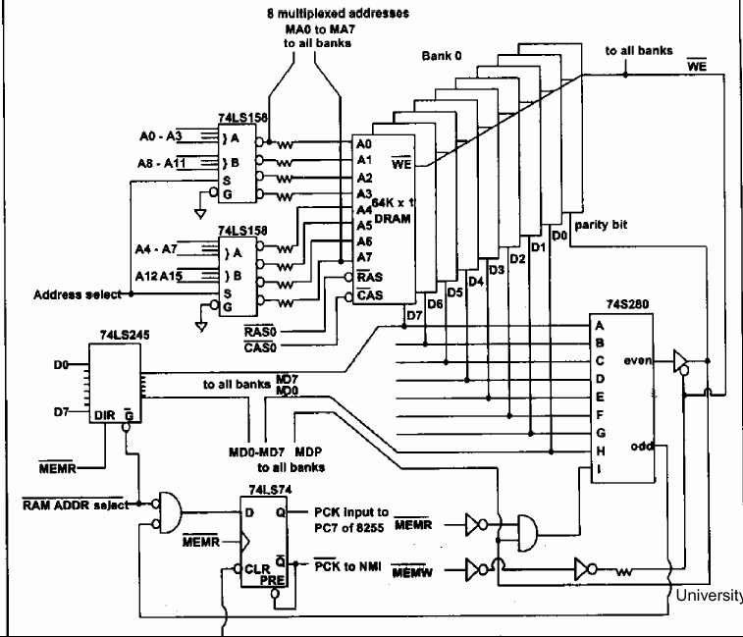
DRAM Connections in PC
Parity?

Slide 14
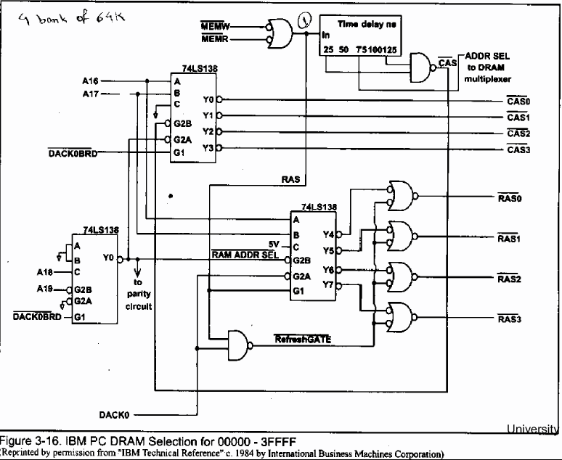
PC RAM Interface

Slide 15
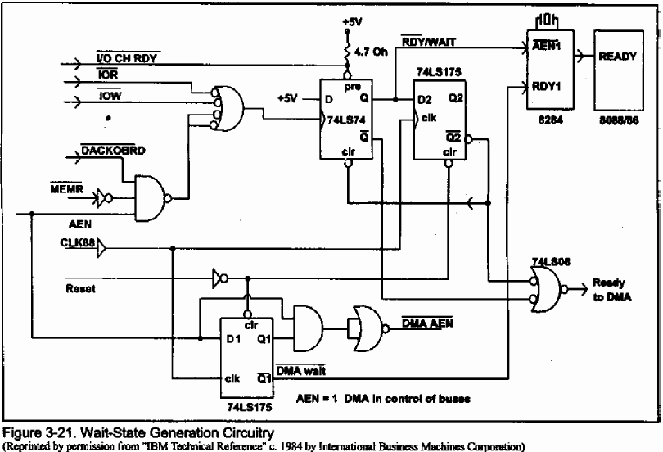
Wait State Generation

Slide 16
DRAM Refresh
Many strategies
Logic on chip
Here a row counter

